Slide 1
Term Project Final Report
Mixed Integer Linear Programming Problem
For Personnel Multi-day Shift Scheduling
Amir Hossein Nobil, Seyed Mohammad Ebrahim Sharifnia
, Leopoldo Eduardo Cardenas-Baeeon 13 June 2021
Pan Nai-Lun R10546022
Li Yue-Hong R10546027

Slide 2

CONTENTS
1
Introduction
2
The Model Formulation
3
The Results obtained from Gurobi+Python
4
Discussion and Analysis
5
Conclusions

Slide 3
INTRODUCTION

Slide 4
Background
Difficulties in personnel Scheduling
Labor cost accounts for big amounts of business costs
Labor Standard Act
Rising awareness of labor right
Case study : Taipei Veterans General Hospital

Slide 5
Assumptions
The total number of personnel : 22
The total number of staff required per shift of each day is determined
Homogeneous : Same skills (NURSE)
The overtime, holidays and overnight payroll costs are determined
Four types of shifts : Morning(D), Evening(G), Morning & Evening(L), Night(N)
Personnel who work 12-hour shifts must rest the following day (Satisfaction)
No staff can work 24h a day
Each staff member must work 144 hours per month and can be assigned to one shift from the above four types
Total and per shift maximum overtime is specified (46 hours per week in Taiwan)

Slide 6
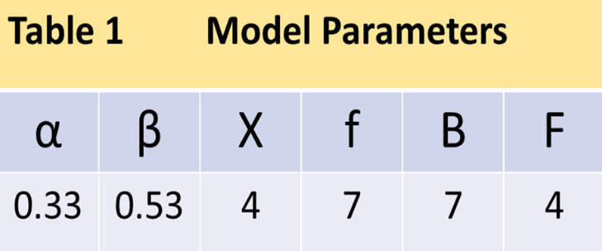
Parameter Setting :
α: Percentage added to base salary for working on overtime or holiday
β: Percentage added to base salary for working on overnight
F: Maximum day that L-type staff can work in the morning and/or evening shifts as overtime
B: Maximum day that D/G-type staff can work in the morning and/or evening shifts as overtime
x: Maximum day that D/G-type staff can work in the night shifts as overtime
f: Maximum day that N-type staff can work in the morning and/or evening shifts as overtime

Slide 7
S_{i}: Monthly payroll of staff i, including base pay and all other benefits
C_{i}: Payroll of 1-hour work of staff I, yields by dividing the base pay minimum
working time of staff (S_{i}/W)
Minimum working time of each staff = 144 hours
Maximum working time of each staff = 206 hours
Notes:
(年資愈高，Si愈高)
Ci 用於計算加班費

Slide 8
The Model Formulation

Slide 9
Decision variables:
Di: Binary variable determines if staff i works on the morning shift or not
Gi: Binary variable determines if staff i works on the evening shift or not
Li: Binary variable determines if staff i works on the morning and evening shift or not
Ni: Binary variable determines if staff i works on the night shift or not
dij: Binary variable determines if staff i works on the morning shift of day j or not
gij: Binary variable determines if staff i works on the evening shift of day j or not
lij: Binary variable determines if staff i works on the morning and evening shift of day j or not
nij: Binary variable determines if staff i works on the night shift of day j or not
Shift Allocation
Work or not ?

Slide 10
Decision variables:
ngij: Binary variable determines if G-type staff i works on the night shift of day j or not
gnij: Binary variable determines if N-type staff i works on the evening shift of day j or not
glij: Binary variable determines if L-type staff i works on the evening shift of day j or not
gdij: Binary variable determines if D-type staff i works on the evening shift of day j or not
ndij: Binary variable determines if D-type staff i works on the night shift of day j or not
dnij: Binary variable determines if N-type staff i works on the morning shift of day j or not
dlij: Binary variable determines if L-type staff i works on the morning shift of day j or not
dgij: Binary variable determines if G-type staff i works on the morning shift of day j or not
tij: Total off-day working hours of staff i on day j
Ui: Total working hours of staff i
Overtime shift
Others

Slide 11
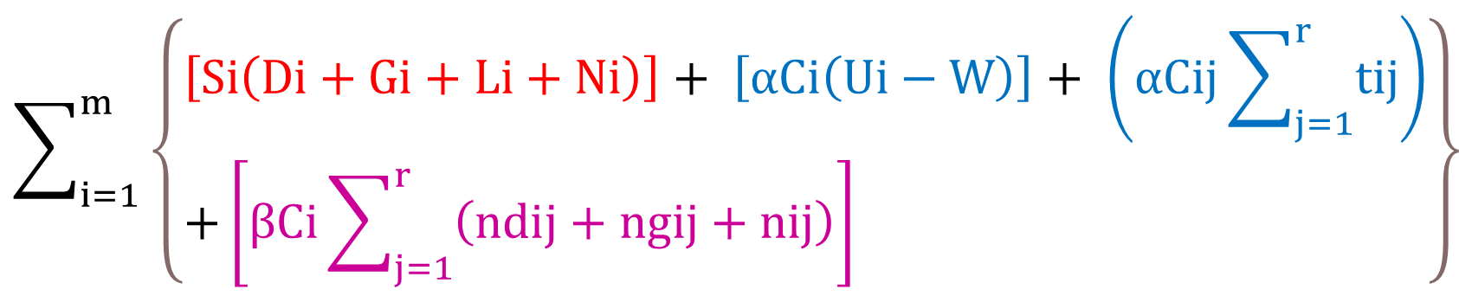
Objective:
$$\sum_{i=1}^{m}{\left\{\begin{aligned}&\left[Si\left(Di+Gi+Li+Ni\right)\right]+ \left[αCi\left(Ui−W\right)\right]+ \left(αCij\sum_{j=1}^{r}{tij}\right) \\ &+\left[βCi\sum_{j=1}^{r}{\left(ndij+ngij+nij\right)}\right]\end{aligned}\right\}}$$

Slide 12

Constraints:
$Di+Gi+Li+Ni=1; ∀i$
$dij≥24Di; ∀i,j$
$dij≤Di; ∀i,j$
$gij≥24Gi; ∀i,j$
$gij≤Gi;∀i,j$
$lij≥12Li;∀i,j$
$lij≤Li;∀i,j$
$nij≥12Ni;∀i,j$
$nij≤Ni;∀i,j$
Minimum working day

Slide 13

Constraints:
$ngij≤Gix;∀i,j$
$gnij≤Nif;∀i,j$
$ndij≤Dix;∀i,j$
$dnij≤Nif;∀i,j$
$glij≤LiF;∀i,j$
$gdij≤DiB;∀i,j$
$dgij≤GiB;∀i,j$
$dlij≤LiF;∀i,j$

Slide 14
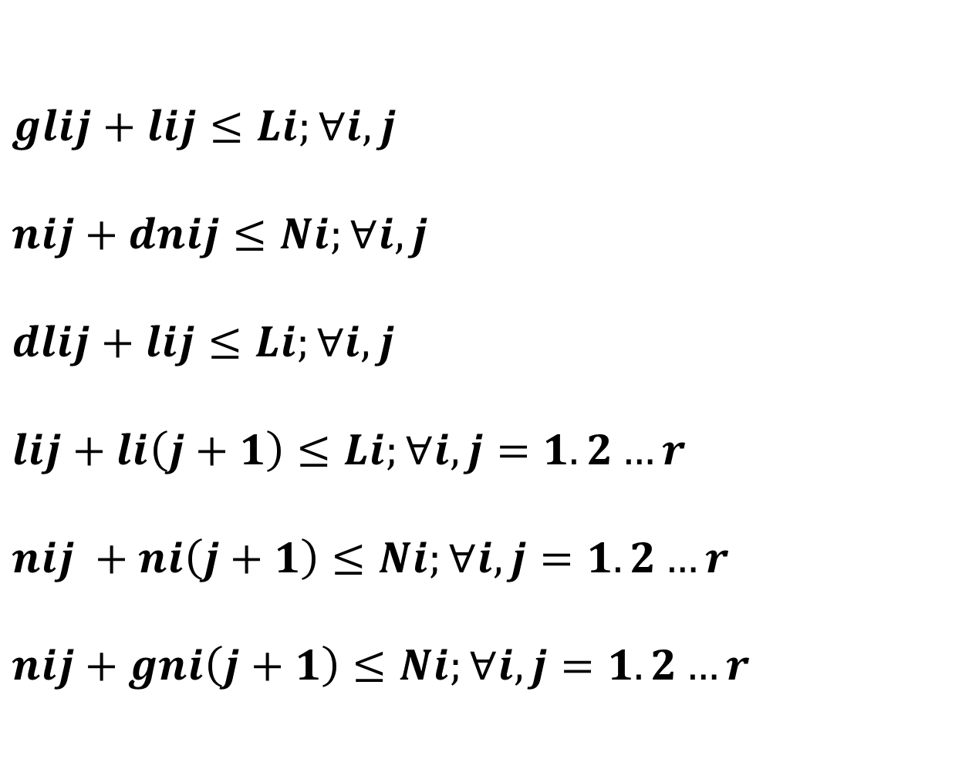
Constraints:
$glij+lij≤Li;∀i,j$
$nij+dnij≤Ni;∀i,j$
$dlij+lij≤Li;∀i,j$
$lij+li\left(j+1\right)≤Li;∀i,j=1.2…r$
$nij +ni\left(j+1\right)≤Ni;∀i,j=1.2…r$
$nij+gni\left(j+1\right)≤Ni;∀i,j=1.2…r$

Slide 15
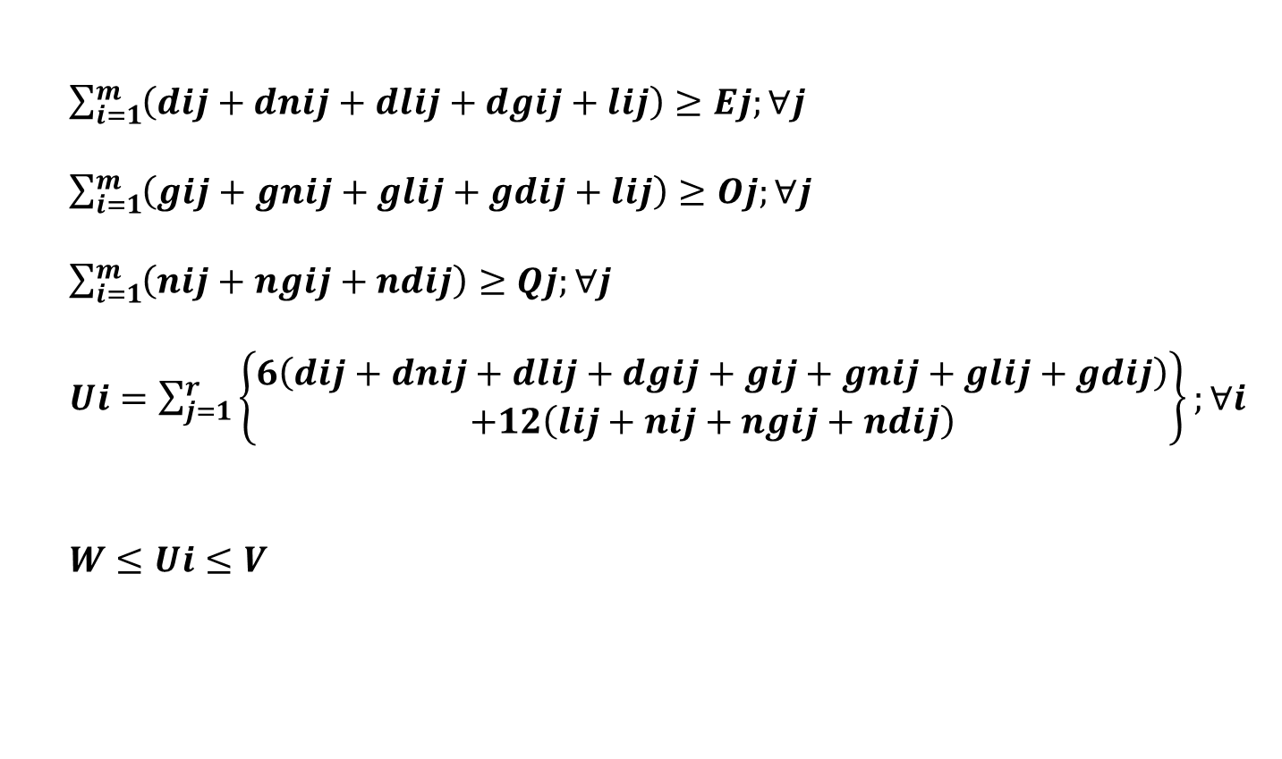
Constraints:
$\sum_{i=1}^{m}{\left(dij+dnij+dlij+dgij+lij\right)≥Ej;∀j}$
$\sum_{i=1}^{m}{\left(gij+gnij+glij+gdij+lij\right)≥Oj;∀j}$
$\sum_{i=1}^{m}{\left(nij+ngij+ndij\right)≥Qj;∀j}$
$Ui=\sum_{j=1}^{r}{\left\{\begin{aligned}6\left(dij+dnij+dlij+dgij+gij+gnij+glij+gdij\right) \\ +12\left(lij+nij+ngij+ndij\right)\end{aligned}\right\};∀i}$
$W≤Ui≤V$
$$tij=6\left(dij+dnij+dlij+dgij+gij+gnij+glij+gdij\right)$$
$$+12\left(ngij+ndij\right);∀i∈m.j∈Tj$$

Slide 16
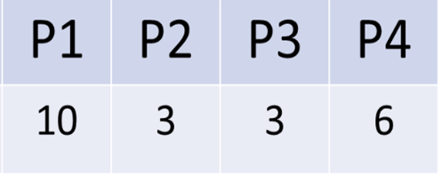
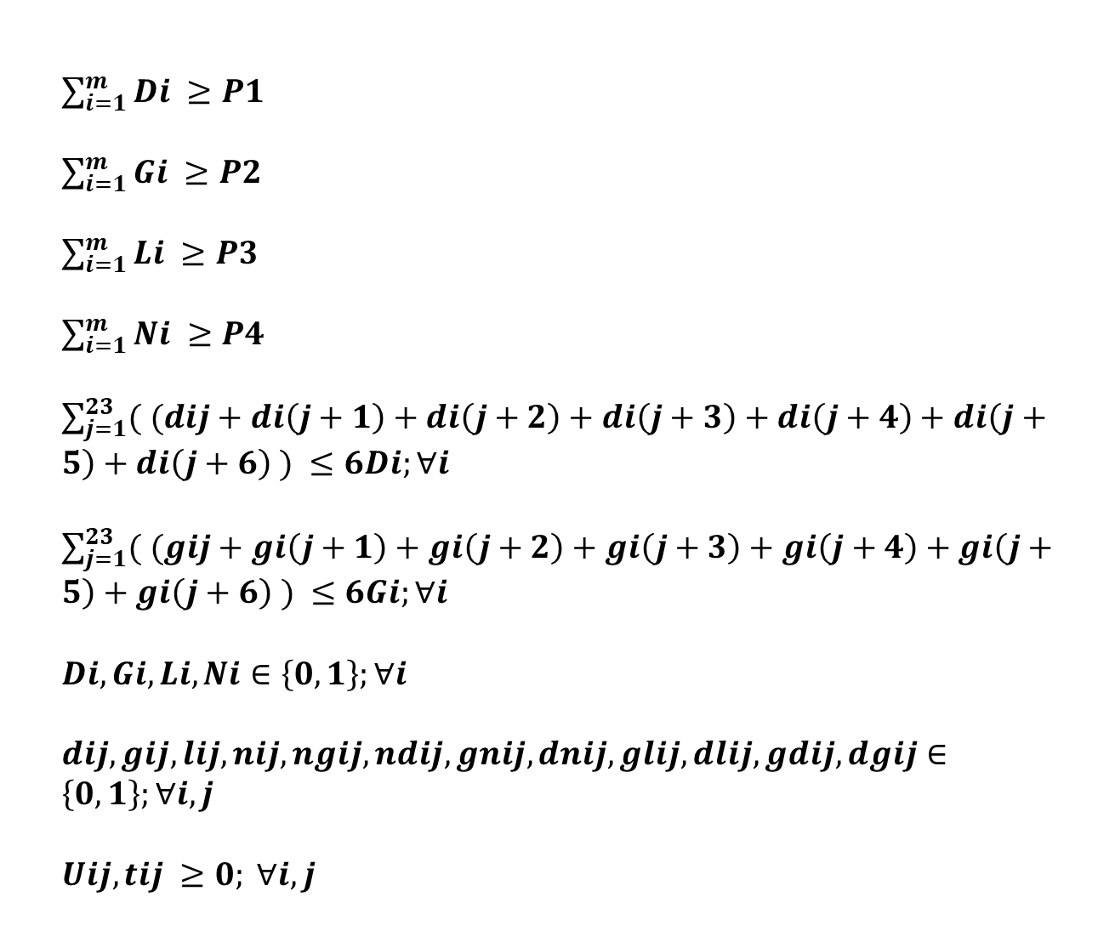
Constraints:
$\sum_{i=1}^{m}{Di ≥P1}$
$\sum_{i=1}^{m}{Gi ≥P2}$
$\sum_{i=1}^{m}{Li ≥P3}$
$\sum_{i=1}^{m}{Ni ≥P4}$
$\sum_{j=1}^{23}{( (dij+di\left(j+1\right)+di\left(j+2\right)+di\left(j+3\right)+di\left(j+4\right)+di\left(j+5\right)+di\left(j+6\right) )} ≤6Di;∀i$
$\sum_{j=1}^{23}{( (gij+gi\left(j+1\right)+gi\left(j+2\right)+gi\left(j+3\right)+gi\left(j+4\right)+gi\left(j+5\right)+gi\left(j+6\right) )} ≤6Gi;∀i$
$Di,Gi,Li,Ni∈\left\{0,1\right\};∀i$
$dij,gij,lij,nij,ngij,ndij,gnij,dnij,glij,dlij,gdij,dgij∈\left\{0,1\right\};∀i,j$
$Uij,tij ≥0; ∀i,j$

Slide 17
Results

Slide 18

Notes:
22護士 排 30天 (1/1~1/30)

Slide 19


5
3
2
Notes:
各班護理師需求數!! (資料來源 : 以勒 護理師)

Slide 20
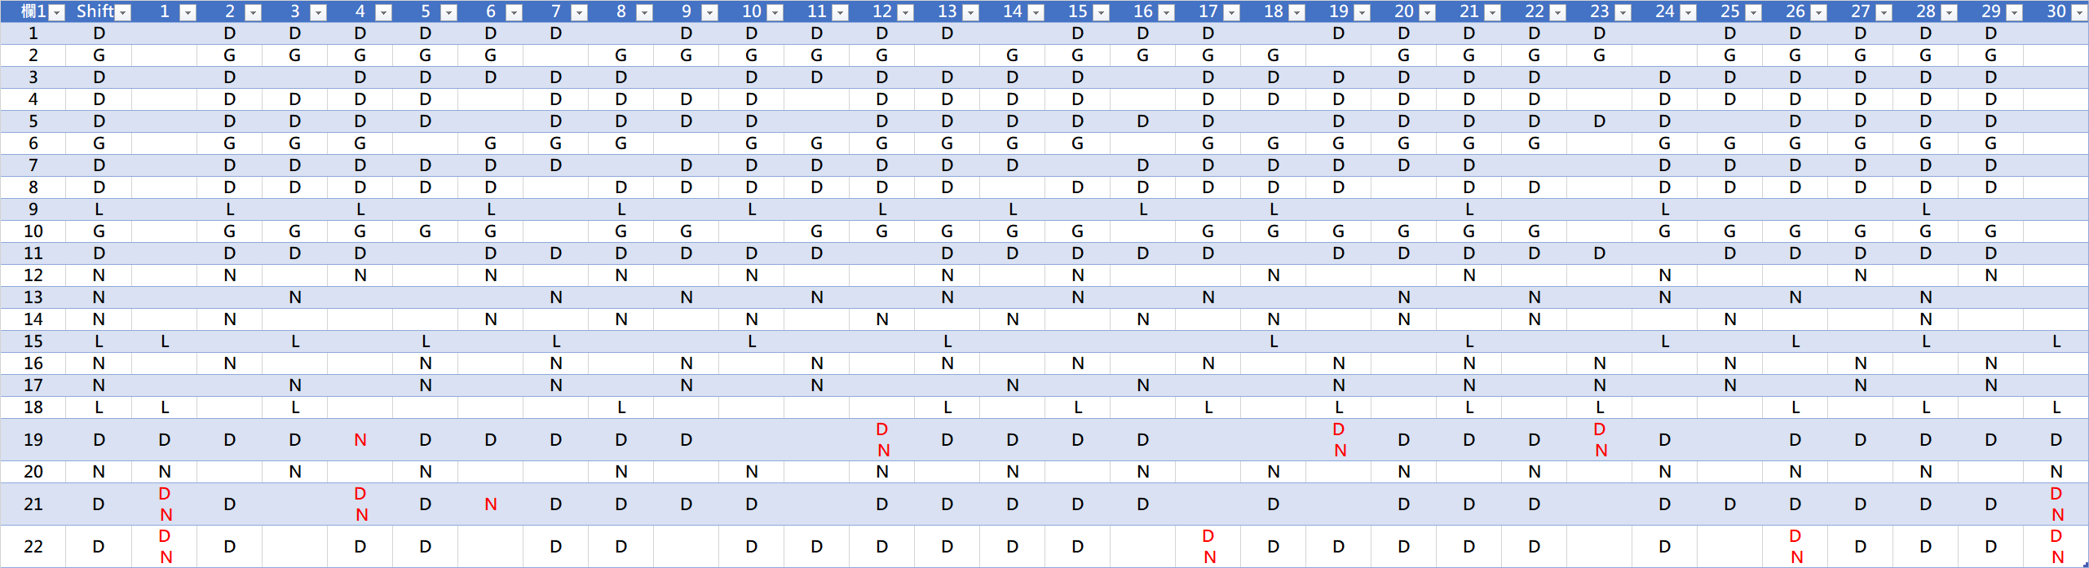
Notes:
紅色的代表加班，事實上1號跟30號的人員都是加班(國定假日)
提醒說明一下 D,G,L,N 代表的班別

Slide 21
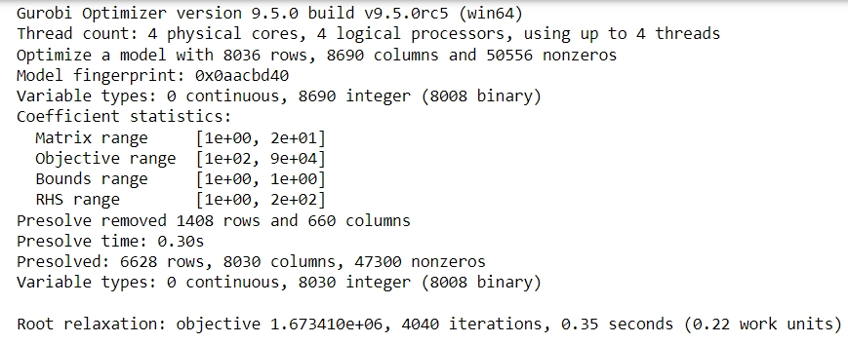

The results obtained from Gurobi + python

Slide 22

Total Cost : NTD 1,673,573
( The current cost is approximate 1,780,000 )
5.9 %
Notes:
與原本的排班模式相比，我們的班表約節省了10萬元

Slide 23
Discussion and Analysis

Slide 24
Omissions
Maintain the simplicity
Work 7 days continuously

Slide 25
Notes:
drawback
第二段，連續工作多天

Slide 26
PART FIVE
Conclusions

Slide 27
Conclusions
Apply to the large scale problem
It’s helpful for schedulers
The problem can be modeled by considering heterogeneous personnel
Consider other factors
It’s useful for hospital to reduce the labor cost.

Slide 28
2
0
2
2
THANKS FOR YOUR LISTENING
*Nobil, A. H., Sharifnia, S. M. E., & Cárdenas-Barrón, L. E. (2022). Mixed integer linear programming problem for personnel multi-day shift scheduling: A case study in an Iran hospital. Alexandria Engineering Journal, 61(1), 419-426.
*https://law.moj.gov.tw/LawClass/LawAll.aspx?PCode=N0030002

